Slide 1
Agents in Artificial Intelligence
Class Teacher:
Prof. A K M Akhtar Hossain
Dept. of CSE
University of Rajshahi, Bangladesh

Slide 2
Agents in AI
An intelligent agent is an entity that makes a decision, that enables artificial intelligence to be put into action.
An intelligent agent /agent is anything that can perceive its environment through sensors and acts upon that environment through effectors.
Basic Types of Agent in Real world Environment:
    A human agent
    An Artificial (robotic) agent
    A software agent

Slide 3
Agents in AI
Basic Types of Agent in Real world Environment:
A human agent has sensory organs such as eyes, ears, nose, tongue and skin parallel to the sensors, and other organs such as hands, legs, mouth, for effectors.
An Artificial (robotic) agent replaces cameras and infrared range finders for the sensors, and various motors and actuators for effectors.
A software agent has encoded bit strings as its programs and actions.

Slide 4
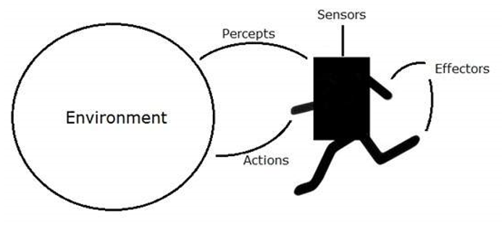
Agents in AI

Slide 5
Agents in AI
Agent Terminology:
  Performance Measure of Agent − It is the criteria, which determines how successful an agent is.
  Behavior of Agent − It is the action that agent performs after any given sequence of percepts.
  Percept − It is agent’s perceptual inputs at a given instance.
  Percept Sequence − It is the history of all that an agent has perceived till date.
  Agent Function − It is a map from the precept sequence to an action.

Slide 6
Agents in AI
Rationality:
  Rationality is nothing but status of being reasonable, sensible, and having good sense of judgment.
  Rationality is concerned with expected actions and results depending upon what the agent has perceived.
  Performing actions with the aim of obtaining useful information is an important part of rationality.
What is Ideal Rational Agent?
An ideal rational agent is the one, which is capable of doing expected actions to maximize its performance measure, on the basis of −
    Its percept sequence
    Its built-in knowledge base

Slide 7
Agents in AI
Rationality of an agent depends on the following:
  The performance measures, which determine the degree of success.
  Agent’s Percept Sequence till now.
  The agent’s prior knowledge about the environment.
  The actions that the agent can carry out.
A rational agent always performs right action, where the right action means the action that causes the agent to be most successful in the given percept sequence.
The problem the agent solves is characterized by Performance Measure, Environment, Actuators, and Sensors.

Slide 8
Agents in AI
Some Terminologies for Agents in AI:
  Percept: It is agent’s perceptual inputs at a given instance.
Actuator: An actuator is a device that makes something move or operate. An actuator is a device that uses a form of power to convert a control signal into mechanical motion.
Sensor: A sensor is a device that detects the change in the environment and responds to some output on the other system.
Effector: An effector is any device that affects the environment.
  Robots control their effectors, which are also known as end effectors.
  Effectors include legs, wheels, arms, fingers, wings and fins.
  Controllers cause the effectors to produce desired effects on the environment.

Slide 9
Agents in AI
The Structure of Intelligent Agents:
  Agent’s structure can be viewed as −
    Agent = Architecture + Agent Program
    Architecture = the machinery that an agent executes on.
    Agent Program = an implementation of an agent function.

Slide 10
Agents in AI
The Structure of Intelligent Agents:
    Simple Reflex Agents
    Model Based Reflex Agents
    Goal Based Agents
    Utility Based Agents
    Learning Based Agents:

Slide 11
The Structure of Intelligent Agents:
Simple Reflex Agents
  They choose actions only based on the current percept.
  They are rational only if a correct decision is made only on the basis of current precept.
  Their environment is completely observable.

Slide 12
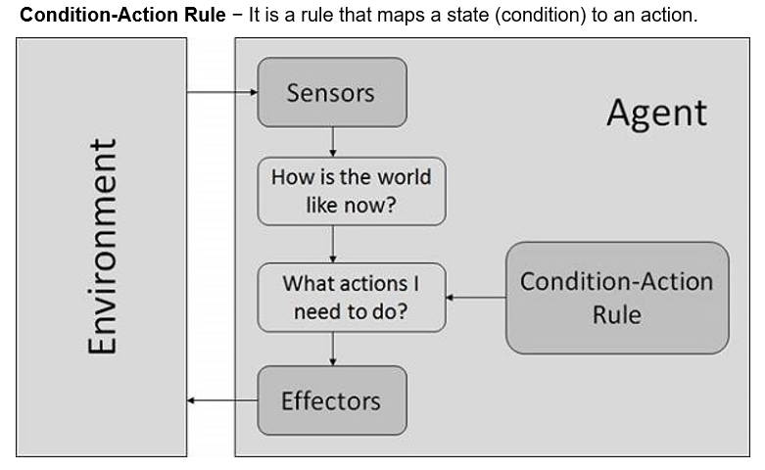
Simple Reflex Agents

Slide 13
The Structure of Intelligent Agents:
Model Based Reflex Agents:
  They use a model of the world to choose their actions. They maintain an internal state.
  Model − knowledge about “how the things happen in the world”.
  Internal State − It is a representation of unobserved aspects of current state depending on percept history.
Updating the state requires the information about −
  How the world evolves.
  How the agent’s actions affect the world.

Slide 14
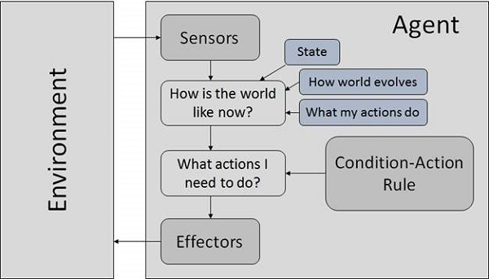
Model Based Reflex Agents:

Slide 15
The Structure of Intelligent Agents:
Goal Based Agents:
  They choose their actions in order to achieve goals.
  Goal-based approach is more flexible than reflex agent since the knowledge supporting a decision is explicitly modeled, thereby allowing for modifications.
  Goal − It is the description of desirable situations.

Slide 16
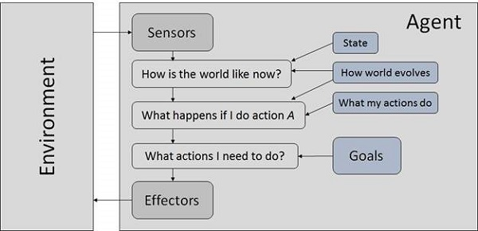
Goal Based Agents

Slide 17
The Structure of Intelligent Agents:
Utility Based Agents:
  They choose actions based on a preference (utility) for each state.
  Goals are inadequate when −
  There are conflicting goals, out of which only few can be achieved.
  Goals have some uncertainty of being achieved and you need to consider likelihood of success against the importance of a goal.

Slide 18
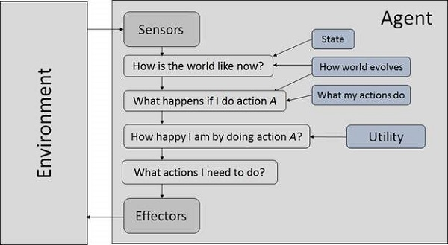
Utility Based Agents:

Slide 19
Learning-based Agent
A learning-based agent is an agent capable of learning from experience.
It has the capability of automatic information acquisition and integration into the system.
Any agent designed and expected to be successful in an. uncertain environment is considered to be learning agent

Slide 20
Learning Based Agents:
An AI agent with learning capabilities or the ability to learn from its experiences in the past is referred to as a "learning agent."
A learning based agent primarily consists of these four conceptual parts:
  Element of learning
  Critic
  Element of performance
  Problem Generator

Slide 21
Learning Based Agents:
Element of learning: It is accountable for producing advancements by absorbing environmental knowledge.
Critic: The learning component uses criticism to gauge how well the agent is performing in relation to a predetermined performance benchmark.
Element of performance: It is in charge of choosing an external action.
Problem Generator: This element is in charge of making recommendations for activities that will result in novel and educational experiences.

Slide 22
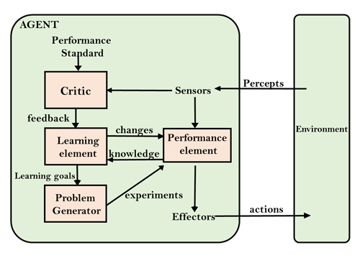
Learning Based Agents:

Slide 23
Agents and Environment in AI
The Nature of Environments:
  Some programs operate in the entirely artificial environment confined to keyboard input, database, computer file systems and character output on a screen.
  In contrast, some software agents (software robots or softbots) exist in rich, unlimited softbots domains.
  The simulator has a very detailed, complex environment.
  The software agent needs to choose from a long array of actions in real time.
  A softbot designed to scan the online preferences of the customer and show interesting items to the customer works in the real as well as an artificial environment.

Slide 24
The Nature of Environments:
The most famous artificial environment is the Turing Test environment, in which one real and other artificial agents are tested on equal ground.
This is a very challenging environment as it is highly difficult for a software agent to perform as well as a human.

Slide 25
What are the challenges arising to design agents for multi-agent environments?
1.Non-Stationary Environment:
Because multiple agents act simultaneously, the environment keeps changing.
The agent cannot assume that rules or patterns remain stable, making learning and prediction harder.

Slide 26
The challenges arising to design agents for multi-agent environments:
2. Coordination and Cooperation Difficulties
Agents must synchronize actions, share tasks, and avoid conflicts.
Poor coordination can lead to deadlocks, collisions, or inefficiency.

Slide 27
The challenges arising …… …..
3. Communication Challenges
Agents often need to exchange information. Issues include:
Limited bandwidth
Delayed or noisy messages
High communication cost
Designing effective protocols

Slide 28
The challenges arising …. …..
4. Competition and Conflicting Goals
Agents may pursue different or opposing goals.
This leads to challenges like:
Adversarial behavior
Deception
Resource contention

Slide 29
The challenges arising …. …..
5. Partial Observability
Each agent has limited information about the world and other agents’ states.
They must infer missing information or maintain belief states.
6. Scalability
As the number of agents increases:
Interactions grow rapidly
Computation becomes expensive
Coordination becomes more complex

Slide 30
The challenges arising …. …..
7. Emergent and Unpredictable Behavior
Unexpected global behavior can arise from simple local interactions.
Such emergent behavior is hard to analyze, predict, or control.
8. Multi-Agent Learning Complexity
Learning becomes difficult because:
Rewards depend on many agents’ actions
Policies must adapt as others change
Joint action spaces are huge

Slide 31
The challenges arising …. …..
9. Conflict Resolution
Agents may compete for shared or limited resources.
Mechanisms for negotiation, arbitration, or resource allocation become essential.
10. Ensuring Safety, Fairness, and Ethics
Agents must behave safely in shared environments.
Challenges include:
Avoiding harmful actions
Maintaining fairness
Handling adversarial agents

Slide 32
Turing Test
The success of an intelligent behavior of a system can be measured with Turing Test.
Two persons and a machine to be evaluated participate in the test. Out of the two persons, one plays the role of the tester.
Each of them sits in different rooms. The tester is unaware of who is machine and who is a human.
He interrogates the questions by typing and sending them to both intelligences, to which he receives typed responses.
This test aims at fooling the tester. If the tester fails to determine machine’s response from the human response, then the machine is said to be intelligent.

Slide 33
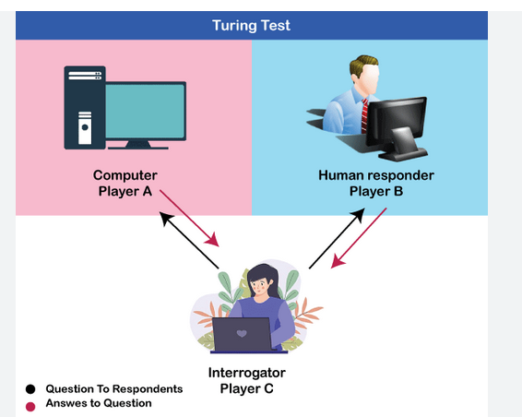
Turing Test

Slide 34
Properties of Environment
The environment has multifold properties −
  Discrete / Continuous − If there are a limited number of distinct, clearly defined, states of the environment, the environment is discrete (For example, chess); otherwise it is continuous (For example, driving).
  Observable / Partially Observable − If it is possible to determine the complete state of the environment at each time point from the percepts it is observable; otherwise it is only partially observable.
  Static / Dynamic − If the environment does not change while an agent is acting, then it is static; otherwise it is dynamic.

Slide 35
Properties of Environment
Single agent / Multiple agents − The environment may contain other agents which may be of the same or different kind as that of the agent.
Accessible / Inaccessible − If the agent’s sensory apparatus can have access to the complete state of the environment, then the environment is accessible to that agent.
Deterministic / Non-deterministic − If the next state of the environment is completely determined by the current state and the actions of the agent, then the environment is deterministic; otherwise it is non-deterministic.
Episodic / Non-episodic − In an episodic environment, each episode consists of the agent perceiving and then acting. The quality of its action depends just on the episode itself. Subsequent episodes do not depend on the actions in the previous episodes. Episodic environments are much simpler because the agent does not need to think ahead.

Slide 36
END TODAY
Thanks

